Slide 1
Mengkombinasikan Teknik Resampling dengan Algoritma Machine Learning Untuk Mengatasi Dataset tak Seimbang
Zinedine Kahlil Gibran Zidane
H13116304

Slide 2
Dataset
Atribut / Fitur
Kelas
Sepal_length | Sepal_width | Petal_length | Petal_width | Species
5.1 | 3.5 | 1.4 | 0.2 | setosa
6.4 | 3.2 | 4.5 | 1.5 | versicolor
6.9 | 3.2 | 5.7 | 2.3 | virginica
5.2 | 4.1 | 1.5 | 0.1 | setosa
6.6 | 2.9 | 4.6 | 1.3 | versicolor
6.1 | 3.0 | 4.9 | 1.8 | virginica
… | … | … | … | …
… | … | … | … | …
Kumpulan data yang berbentuk tabel
Kolom: ciri-ciri, atribut, fitur
Baris: Individu, record, sampel
Data / Observasi
Iris Dataset

Slide 3
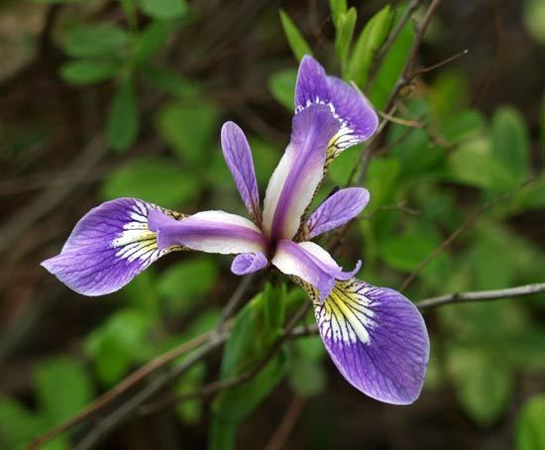
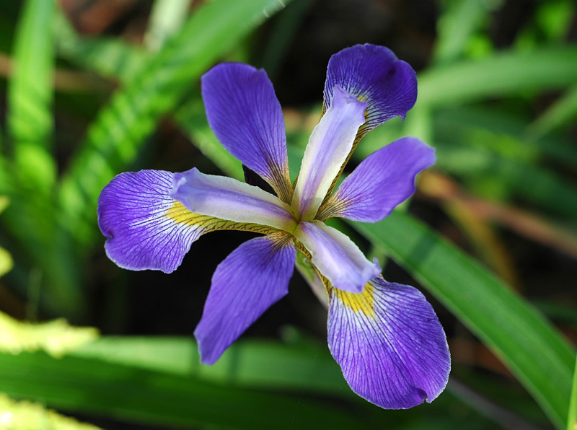
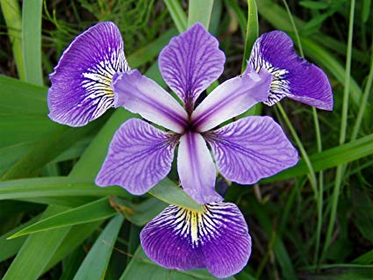
Dataset
Sepal_length | Sepal_width | Petal_length | Petal_width | Species
5.1 | 3.5 | 1.4 | 0.2 | setosa
6.4 | 3.2 | 4.5 | 1.5 | versicolor
6.9 | 3.2 | 5.7 | 2.3 | virginica
5.2 | 4.1 | 1.5 | 0.1 | setosa
6.6 | 2.9 | 4.6 | 1.3 | versicolor
6.1 | 3.0 | 4.9 | 1.8 | virginica
… | … | … | … | …
… | … | … | … | …
setosa
virginica
versicolor
Image taken from Google Images

Slide 4
Data Training & Data Testing
Sepal_length | Sepal_width | Petal_length | Petal_width | Species
Sepal_length | Sepal_width | Petal_length | Petal_width | Species
5.1 | 3.5 | 1.4 | 0.2 | setosa
6.4 | 3.2 | 4.5 | 1.5 | versicolor
6.9 | 3.2 | 5.7 | 2.3 | virginica
5.2 | 4.1 | 1.5 | 0.1 | setosa
6.6 | 2.9 | 4.6 | 1.3 | versicolor
6.1 | 3.0 | 4.9 | 1.8 | virginica
5.4 | 3.7 | 1.5 | 0.2 | setosa
6.7 | 3.0 | 5.2 | 2.3 | virginica
6.9 | 3.1 | 5.1 | 2.3 | virginica
5.6 | 2.7 | 4.2 | 1.3 | versicolor
100%
4.8 | 3.0 | 1.4 | 0.1 | setosa
5.1 | 2.5 | 3.0 | 1.1 | versicolor
6.1 | 3.0 | 4.6 | 1.4 | versicolor
5.1 | 3.5 | 1.4 | 0.3 | setosa
6.0 | 2.7 | 5.1 | 1.6 | versicolor
7.7 | 3.0 | 6.1 | 2.3 | virginica
… | … | … | … | …
… | … | … | … | …

Slide 5
Data Training & Data Testing
Data Training
Data Testing
Sepal_length | Sepal_width | Petal_length | Petal_width | Species
Sepal_length | Sepal_width | Petal_length | Petal_width | Species
5.1 | 3.5 | 1.4 | 0.2 | setosa
6.4 | 3.2 | 4.5 | 1.5 | versicolor
6.9 | 3.2 | 5.7 | 2.3 | virginica
5.2 | 4.1 | 1.5 | 0.1 | setosa
6.6 | 2.9 | 4.6 | 1.3 | versicolor
6.1 | 3.0 | 4.9 | 1.8 | virginica
5.4 | 3.7 | 1.5 | 0.2 | setosa
6.7 | 3.0 | 5.2 | 2.3 | virginica
6.9 | 3.1 | 5.1 | 2.3 | virginica
5.6 | 2.7 | 4.2 | 1.3 | versicolor
4.8 | 3.0 | 1.4 | 0.1 | setosa
5.1 | 2.5 | 3.0 | 1.1 | versicolor
6.1 | 3.0 | 4.6 | 1.4 | versicolor
5.1 | 3.5 | 1.4 | 0.3 | setosa
6.0 | 2.7 | 5.1 | 1.6 | versicolor
7.7 | 3.0 | 6.1 | 2.3 | virginica
30%
… | … | … | … | …
70%
… | … | … | … | …
Melatih model Machine Learning
Menguji model Machine Learning

Slide 6
Machine Learning
Training
Sepal_length | Sepal_width | Petal_length | Petal_width | Species
5.1 | 3.5 | 1.4 | 0.2 | setosa
6.4 | 3.2 | 4.5 | 1.5 | versicolor
6.9 | 3.2 | 5.7 | 2.3 | virginica
5.2 | 4.1 | 1.5 | 0.1 | setosa
6.6 | 2.9 | 4.6 | 1.3 | versicolor
6.1 | 3.0 | 4.9 | 1.8 | virginica
5.4 | 3.7 | 1.5 | 0.2 | setosa
6.7 | 3.0 | 5.2 | 2.3 | virginica
6.9 | 3.1 | 5.1 | 2.3 | virginica
5.6 | 2.7 | 4.2 | 1.3 | versicolor
0 < petal_width < 0.5
0 < petal_length < 2
setosa:
ML
versicolor:
0.5 <= petal_width <= 2
Knowledge
virginica:
5.5 < sepal_length
… | … | … | … | …

Slide 7
Machine Learning
Testing
Sepal_length | Sepal_width | Petal_length | Petal_width | Species
Prediksi
setosa
versicolor
setosa
setosa
virginica
virginica
…
4.8 | 3.0 | 1.4 | 0.1 | setosa
5.1 | 2.5 | 3.0 | 1.1 | versicolor
6.1 | 3.0 | 4.6 | 1.4 | versicolor
5.1 | 3.5 | 1.4 | 0.3 | setosa
6.0 | 2.7 | 5.1 | 1.6 | versicolor
7.7 | 3.0 | 6.1 | 2.3 | virginica
ML
0 < petal_width < 0.5
0 < petal_length < 2
setosa:
… | … | … | … | …
versicolor:
0.5 <= petal_width <= 2
Accuracy: 86%
virginica:
5.5 < sepal_length
Knowledge

Slide 8
Machine Learning
ML
Support Vector Machines
Artificial Neural Network
Logistic Regression
Decision Tree
Naïve Bayes
K-Means
K-Medoids
K-Modes
Linear Regression
Random Forest
Bayesian Network
Apriori
K-Nearest Neighbors
Hierarchical Clustering
Expectation Maximization
AdaBoost
Ordinary Least Squares Regression

Slide 9
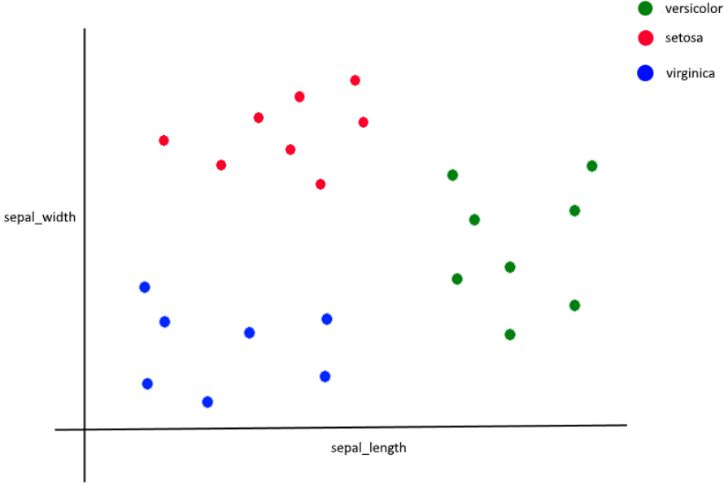

Slide 11
k = 3

Slide 12
Confusion Matrix
no | …
Aktual
Hamil
Hamil
Tidak Hamil
Tidak Hamil
Prediksi
Hamil
Tidak Hamil
Hamil
Tidak Hamil
1 | …
2 | …
3 | …
4 | …
True Positive
False Negative
False Positive
True Negative
Pregnancy dataset

Slide 13
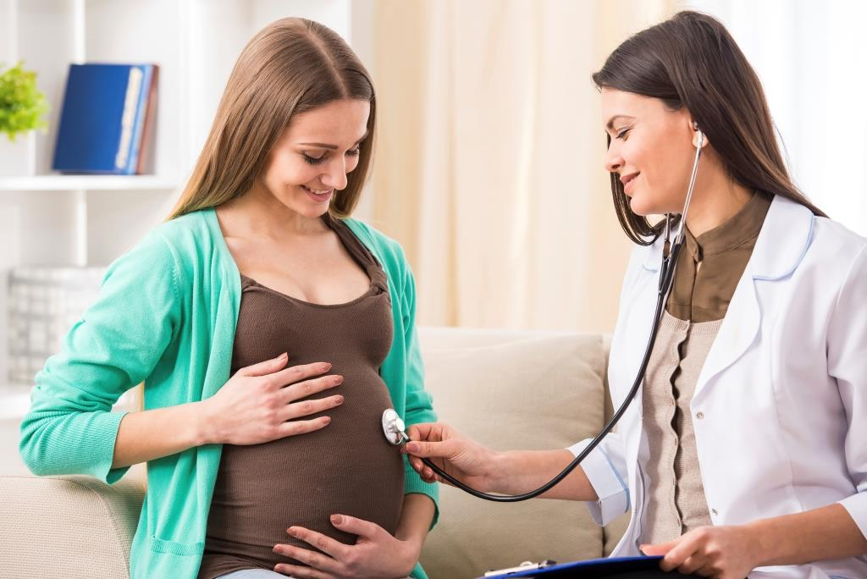
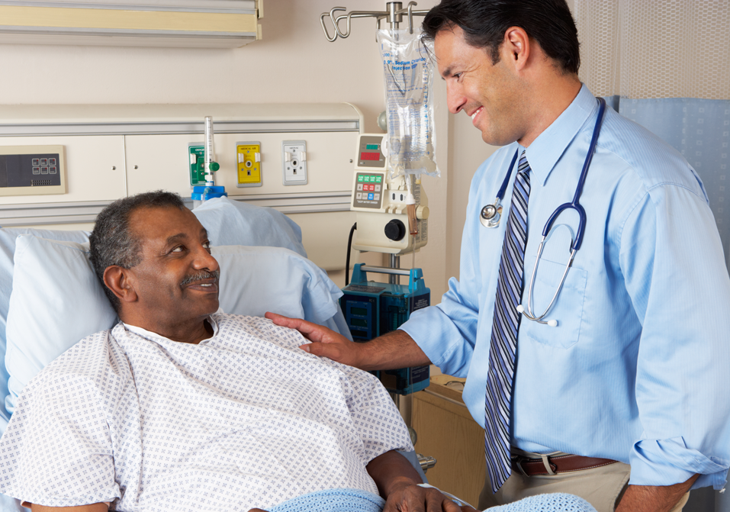
Aktual
Hamil
Tidak Hamil
Anda Hamil
Anda Hamil
Hamil
TRUE POSITIVE
FALSE POSITIVE
Prediksi
Anda
Tidak
Hamil
Anda Tidak Hamil
Tidak Hamil
FALSE NEGATIVE
TRUE NEGATIVE

Slide 14
Confusion Matrix
Aktual
POSITIVE
NEGATIVE
POSITIVE
TRUE POSITIVE
FALSE POSITIVE
Prediksi
NEGATIVE
FALSE NEGATIVE
TRUE NEGATIVE

Slide 15
Confusion Matrix
Aktual
POSITIVE
NEGATIVE
7
76
7
76
POSITIVE
76
Prediksi
3
3
14
14
NEGATIVE
14

Slide 16
Confusion Matrix
+
90
76
14
Aktual
=
= 90%
Accuracy:
+
+
+
100
3
76
14
7
POSITIVE
NEGATIVE
76
7
POSITIVE
Precision:
Prediksi
NEGATIVE
3
14
Recall:

Slide 17
Confusion Matrix
+
90
76
14
Aktual
=
= 90%
Accuracy:
+
+
+
100
3
76
14
7
POSITIVE
NEGATIVE
76
7
76
POSITIVE
Precision:
= 91%
Prediksi
+
76
7
NEGATIVE
3
14
Recall:

Slide 18
Confusion Matrix
+
90
76
14
Aktual
=
= 90%
Accuracy:
+
+
+
100
3
76
14
7
POSITIVE
NEGATIVE
76
7
76
POSITIVE
Precision:
= 91%
Prediksi
+
76
7
NEGATIVE
3
14
76
= 96%
Recall:
+
76
3

Slide 19
Confusion Matrix
Aktual
Performa Algoritma
Secara Menyeluruh
Accuracy:
POSITIVE
NEGATIVE
76
7
POSITIVE
Precision:
Prediksi
NEGATIVE
3
14
Recall:

Slide 20
Confusion Matrix
Aktual
Performa Algoritma
Secara Menyeluruh
Accuracy:
POSITIVE
NEGATIVE
50
50
Seberapa dapat dipercaya hasil
Prediksi terhadap suatu kelas
POSITIVE
Precision:
Prediksi
NEGATIVE
3
14
Recall:

Slide 21
Confusion Matrix
Aktual
Performa Algoritma
Secara Menyeluruh
Accuracy:
POSITIVE
NEGATIVE
10
50
Seberapa dapat dipercaya hasil
Prediksi terhadap suatu kelas
POSITIVE
Precision:
Prediksi
NEGATIVE
90
14
Seberapa baik algoritma dalam
Memprediksi suatu kelas
Recall:

Slide 22
Imbalanced Dataset
diabetes dataset
age | glucose | insulin | … | BMI | diabetes
50 | 155 | 0 | … | 36.2 | negative
31 | 196 | 0 | … | 42.1 | positive
33 | 88 | 33 | … | 23.7 | negative
21 | 121 | 0 | … | 31.0 | negative
47 | 140 | 42 | … | 29.9 | negative
45 | 95 | 95 | … | 42.5 | negative
… | … |  | … | … | …
count(diabetes==‘negative’) = 957
count(diabetes==‘positive’) = 43

Slide 23
Imbalanced Dataset

Slide 24
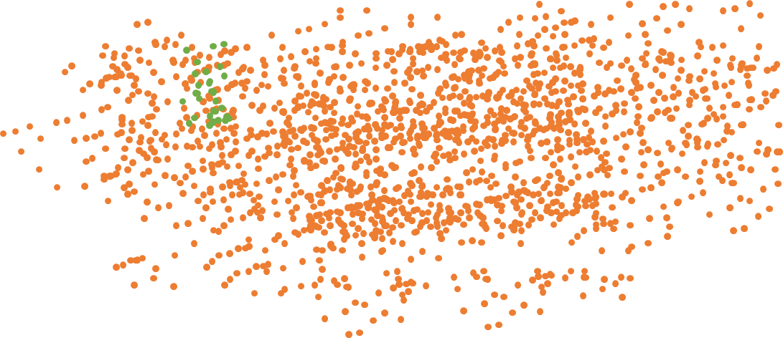
Imbalanced Dataset
X2
X1

Slide 25
Imbalanced Dataset
X2
X1

Slide 26
Resampling
Oversampling
Undersampling

Slide 27
Resampling
Oversampling
Undersampling

Slide 28
Imbalanced Dataset
X2
X1

Slide 29
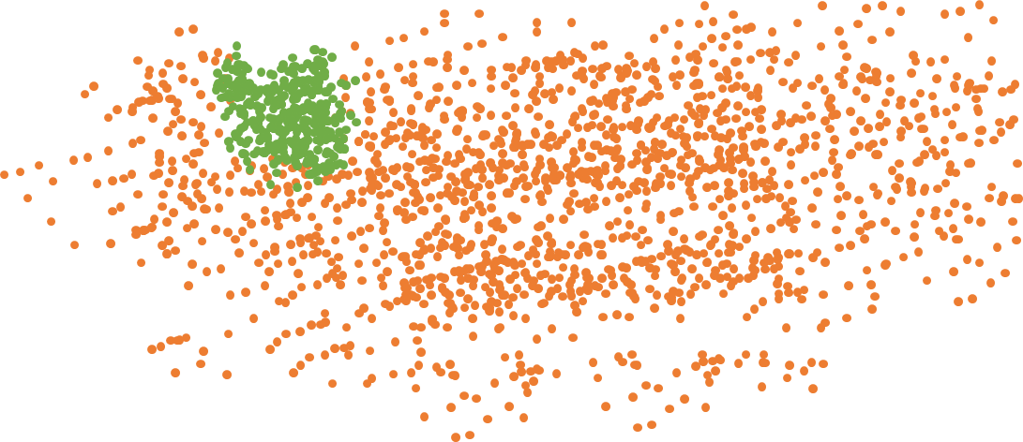
Imbalanced Dataset
X2
X1

Slide 30
Resampling
Oversampling
Undersampling

Slide 31
Resampling
Oversampling
Undersampling

Slide 32
Imbalanced Dataset
X2
X1

Slide 33
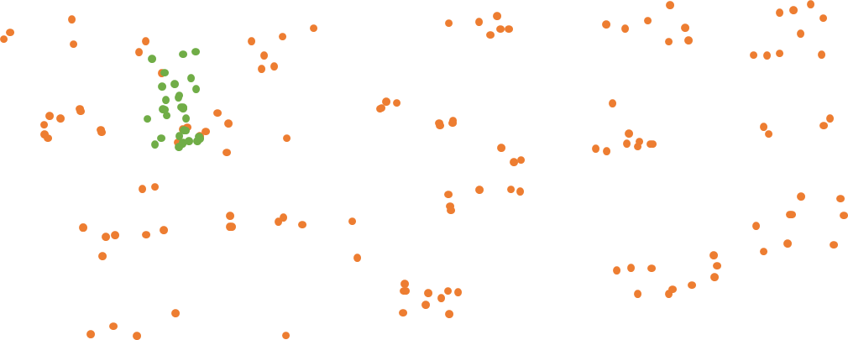
Imbalanced Dataset
X2
X1

Slide 34
Resampling
Oversampling
Undersampling

Slide 35
Resampling
Oversampling
Undersampling
Random Oversampling
Random Undersampling
SMOTE
Sampling Based on Cluster
Borderline-SMOTE
Tomek Links
Modified-SMOTE
NearMiss
SMOTE-NC
Edited Nearest Neighbours
SOMO
Condensed Nearest Neighbours
ADASYN
Instance Hardness Threshold

Slide 36
Proposed Techniques & Algorithms
Machine Learning Algorithms
Oversampling
Undersampling
Support Vector Machines
Random Oversampling
Random Undersampling
Apriori
Artificial Neural Network
SMOTE
Sampling Based on Cluster
AdaBoost
Logistic Regression
Borderline-SMOTE
Tomek Links
Random Forest
Decision Tree
Modified-SMOTE
NearMiss
Bayesian Network
Naïve Bayes
SMOTE-NC
Linear Regression
Edited Nearest Neighbours
K-Means
K-Nearest Neighbors
SOMO
Condensed Nearest Neighbours
K-Medoids
ADASYN
Hierarchical Clustering
Instance Hardness Threshold
K-Modes
Expectation Maximization
Ordinary Least Squares Regression

Slide 37
Proposed Techniques & Algorithms
Machine Learning Algorithms
Oversampling
Undersampling
Support Vector Machines
Random Oversampling
Random Undersampling
Artificial Neural Network
SMOTE
Logistic Regression
Borderline-SMOTE
Tomek Links
Decision Tree
Naïve Bayes
K-Nearest Neighbors
ADASYN

Slide 38
Proposed Techniques & Algorithms
Machine Learning Algorithms
Resampling Techniques
Support Vector Machines
Random Oversampling
Artificial Neural Network
SMOTE
Logistic Regression
Dataset
Borderline-SMOTE
Decision Tree
Random Undersampling
Naïve Bayes
Credit Card Fraud Dataset
Tomek Links
K-Nearest Neighbors
Spambase Dataset
ADASYN
Image Segmentation Dataset
Batasan Masalah
Dataset tak Seimbang
Dataset dengan kelas biner
Dataset dengan atribut numerik

Slide 39
To-Do (Contoh Hasil)
Dataset | ML Algorithm | Resampling | Acc | Pre | Rec | AUC
Credit | SVM | Random Oversampling | 98 | 88 | 43 | 0.88
Spambase | SVM | Random Oversampling | 96 | 91 | 25 | 0.67
Image | SVM | Random Oversampling | 97 | 79 | 77 | 0.75
Credit | Logistic Regression | Random Oversampling | 77 | 67 | 91 | 0.66
Spambase | Logistic Regression | Random Oversampling | 88 | 88 | 86 | 0.75
Image | Logistic Regression | Random Oversampling | 75 | 65 | 77 | 0.61
… | … | … | … | … | … | …
… | … | … | … | … | … | …
Credit | KNN | ADASYN | 79 | 46 | 54 | 0.79
Spambase | KNN | ADASYN | 76 | 53 | 65 | 0.83
Image | KNN | ADASYN | 86 | 61 | 84 | 0.84

Slide 40
Research Target
Algoritma ML terbaik
Teknik Resampling terbaik
Kombinasi teknik Resampling dengan algoritma ML terbaik
Undersampling atau Oversampling
ML Algorithm | Average Acc | Average Pre | Average Rec | Average AUC
SVM | 95.20 | 98 | 88 | 0.67
ANN (MLP) | 92.53 | 96 | 91 | 0.71
Logistic Regression | 87.12 | 97 | 79 | 0.82
Naïve Bayes | 77.18 | 77 | 67 | 0.77
Decision Tree | 82.32 | 88 | 88 | 0.83
KNN | 87.42 | 79 | 46 | 0.79

Slide 41
Research Target
Algoritma ML terbaik
Teknik Resampling terbaik
Kombinasi teknik Resampling dengan algoritma ML terbaik
Undersampling atau Oversampling
Resampling Technique | Average Acc | Average Pre | Average Rec | Average AUC
Random Oversampling | 95.20 | 75 | 76 | 43
SMOTE | 92.53 | 87 | 96 | 25
Borderline-SMOTE | 87.12 | 46 | 56 | 77
ADASYN | 77.18 | 86 | 74 | 91
Tomek Links | 82.32 | 56 | 34 | 86
Random Undersampling | 87.42 | 79 | 86 | 54

Slide 42
Research Target
Algoritma ML terbaik
Teknik Resampling terbaik
Kombinasi teknik Resampling dengan algoritma ML terbaik
Undersampling atau Oversampling

Slide 43
Research Target
Algoritma ML terbaik
Teknik Resampling terbaik
Kombinasi teknik Resampling dengan algoritma ML terbaik
Undersampling atau Oversampling

Slide 44
Done

Slide 45
Resampling

Slide 46
Imbalanced Dataset
X2
X1

Slide 47
Imbalanced Dataset
X2
X1

Slide 48
Imbalanced Dataset
X2
X1

Slide 49
Support Vector Machines
Artificial Neural Network
Logistic Regression
Decision Tree
Naïve Bayes
K-Means
K-Medoids
K-Modes
Linear Regression
Random Forest
Bayesian Network
Apriori
K-Nearest Neighbors
Hierarchical Clustering
Expectation Maximization
AdaBoost
Ordinary Least Squares Regression

Slide 50
Random Oversampling
Frekuensi
X2
32
8
X1

Slide 51
Random Oversampling
Frekuensi
X2
32
32
X1

Slide 52
SMOTE
X2
Frekuensi
32
8
X1

Slide 53
SMOTE
X2
Frekuensi
Parameter
32
k = 5
8
os = 300%
X1

Slide 54
SMOTE
X2
Frekuensi
Parameter
32
k = 5
8
os = 300%
X1

Slide 55
SMOTE
X2
Frekuensi
Parameter
32
k = 5
8
os = 300%
X1

Slide 56
SMOTE
X2
Frekuensi
Parameter
32
k = 5
11
os = 300%
X1

Slide 57
SMOTE
X2
Frekuensi
Parameter
32
k = 5
11
os = 300%
X1

Slide 58
SMOTE
X2
Frekuensi
Parameter
32
k = 5
14
os = 300%
X1

Slide 59
SMOTE
X2
Frekuensi
Parameter
32
k = 5
32
os = 300%
X1

Slide 60
Borderline-SMOTE
X2
Frekuensi
32
10
X1

Slide 61
Borderline-SMOTE
X2
Frekuensi
32
10
X1

Slide 62
Borderline-SMOTE
X2
Frekuensi
32
10
X1

Slide 63
Random Undersampling
Frekuensi
X2
32
8
X1

Slide 64
Random Undersampling
Frekuensi
X2
8
8
X1

Slide 65
Random Undersampling
Frekuensi
X2
8
8
X1

Slide 66
Random Undersampling
Frekuensi
X2
8
8
X1

Slide 67
Tomek Links
Frekuensi
32
8
X1

Slide 68
Tomek Links
Frekuensi
32
8
X1

Slide 69
Tomek Links
Frekuensi
29
8
X1

Slide 70
Tomek Links
Frekuensi
29
8
X1

Slide 71
ADASYN
Frekuensi
X2
15
5
X1

Slide 72




ADASYN
Frekuensi
X2
G = (15 – 5) * 1
= 10
15
5
$r_{i}$=3/5
$r_{i}$=3/5
$r_{i}$=2/5
$r_{i}$=1/5
$r_{i}$=4/5
X1

Slide 73
ADASYN
Frekuensi
X2
G = (15 – 5) * 1
= 10
15
5
$${\text{∑}r}_{i}=\text{(}\text{3}\text{/5) + (}\text{3}\text{/5) + (2/5) + (1/5) + (4/5)}$$
= 13/5
$r_{i}$=3/5
$r_{i}$=3/5
$r_{i}$=2/5
$r_{i}$=1/5
$r_{i}$=4/5
X1

Slide 74
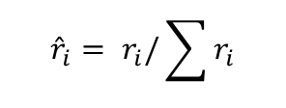
ADASYN
Frekuensi
X2
G = (15 – 5) * 1
= 10
15
5
$${\text{∑}r}_{i}=\text{(}\text{3}\text{/5) + (}\text{3}\text{/5) + (2/5) + (1/5) + (4/5)}$$
= 13/5
$${\hat{r}}_{i}= r_{i}/\sum{r_{i}}$$
$r_{i}$=3/5
$r_{i}$=3/5
$r_{i}$=2/5
$r_{i}$=1/5
$r_{i}$=4/5
X1

Slide 75




ADASYN
Frekuensi
X2
G = (15 – 5) * 1
= 10
15
5
$${\text{∑}r}_{i}=\text{(}\text{3}\text{/5) + (}\text{3}\text{/5) + (2/5) + (1/5) + (4/5)}$$
= 13/5
$${\hat{r}}_{i}= r_{i}/\sum{r_{i}}$$
$\hat{r_{i}}$=0.23
$\hat{r_{i}}$=0.23
$\hat{r_{i}}$=0.16
$\hat{r_{i}}$=0.08
$\hat{r_{i}}$=0.30
X1

Slide 76




ADASYN
Frekuensi
X2
G = (15 – 5) * 1
= 10
15
5
$${\text{∑}r}_{i}=\text{(}\text{3}\text{/5) + (}\text{3}\text{/5) + (2/5) + (1/5) + (4/5)}$$
= 13/5
$${\hat{r}}_{i}= r_{i}/\sum{r_{i}}$$
$s_{i}$=2
$s_{i}$=2
$s_{i}$=2
$s_{i}$=1
$s_{i}$=3
X1

Slide 77
ADASYN
Frekuensi
X2
G = (15 – 5) * 1
= 10
15
15
$${\text{∑}r}_{i}=\text{(}\text{3}\text{/5) + (}\text{3}\text{/5) + (2/5) + (1/5) + (4/5)}$$
= 13/5
$${\hat{r}}_{i}= r_{i}/\sum{r_{i}}$$
X1

